Slide 1
Chapter 1:
Introduction to Bioinformatics
and Functional Genomics
Jonathan Pevsner, Ph.D.
http://bioinfbook.org
pevsner@kennedykrieger.org
Bioinformatics and Functional Genomics
(3rd edition, ©2015 John Wiley & Sons, Ltd.)
You may use this PowerPoint for teaching purposes

Slide 2
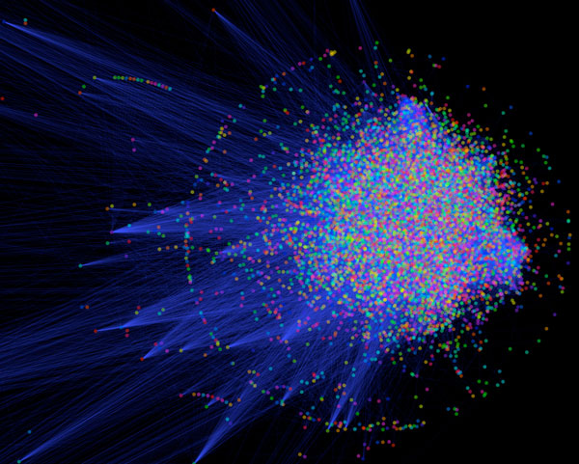

Slide 3


Slide 4
Outline
Organization of the book
Bioinformatics: the big picture
Organization of the chapters
Suggestions For Students and Teachers:
Exercises, Find-a-Gene, Characterize-a-Genome
Bioinformatics software: two cultures
Web-based software
Command-line software
Bridging the two cultures
New paradigms for learning programming
Bioinformatics and other disciplines

Slide 5
Learning objectives
After studying these materials you should be able to do the following:
define the terms bioinformatics;
explain the scope of bioinformatics;
explain why globins are a useful example to illustrate this discipline; and
describe web-based versus command-line approaches to bioinformatics.

Slide 6
Definitions of bioinformatics and genomics
Bioinformatics is the use of computer databases and computer algorithms to analyze proteins, genes, and the complete collection of deoxyribonucleic acid (DNA) that comprises an organism (the genome).
According to a National Institutes of Health (NIH) definition, bioinformatics is “research, development, or application of computational tools and approaches for expand- ing the use of biological, medical, behavioral, or health data, including those to acquire, store, organize, analyze, or visualize such data.”
B&FG 3e
Page 3

Slide 7
Organization of Bioinformatics and Functional Genomics
Part I
Bioinformatics:
alignment, database searching, phylogeny
Part II
Follows the central dogma:
DNA → RNA → protein
genome → transcriptome → proteome
Part III
Genomics: The tree of life
Viruses; bacteria and archaea; eukaryotes
The human genome and human disease
B&FG 3e
Page 4-5

Slide 8
Outline
Organization of the book
Bioinformatics: the big picture
Organization of the chapters
Suggestions For Students and Teachers:
Exercises, Find-a-Gene, Characterize-a-Genome
Bioinformatics software: two cultures
Web-based software
Command-line software
Bridging the two cultures
New paradigms for learning programming
Bioinformatics and other disciplines

Slide 9
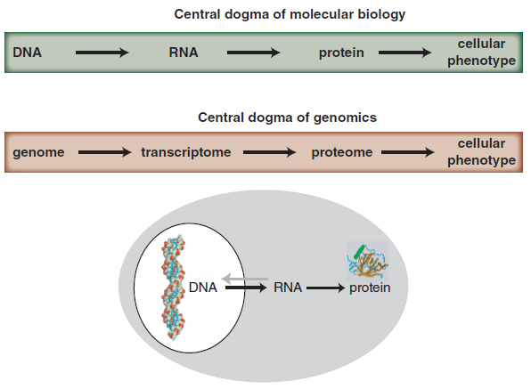
Central dogma of molecular biology & genomics
B&FG 3e
Fig. 1-1
Page 4

Slide 10
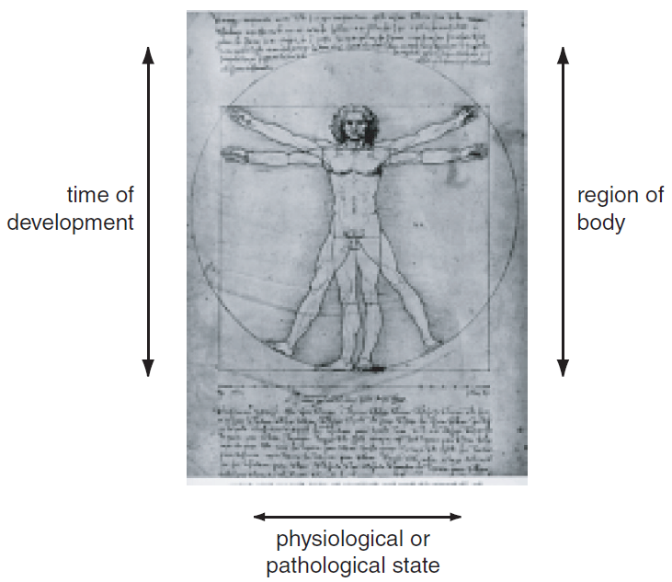
Growth of DNA sequence in repositories
B&FG 3e
Fig. 1-2
Page 6

Slide 11
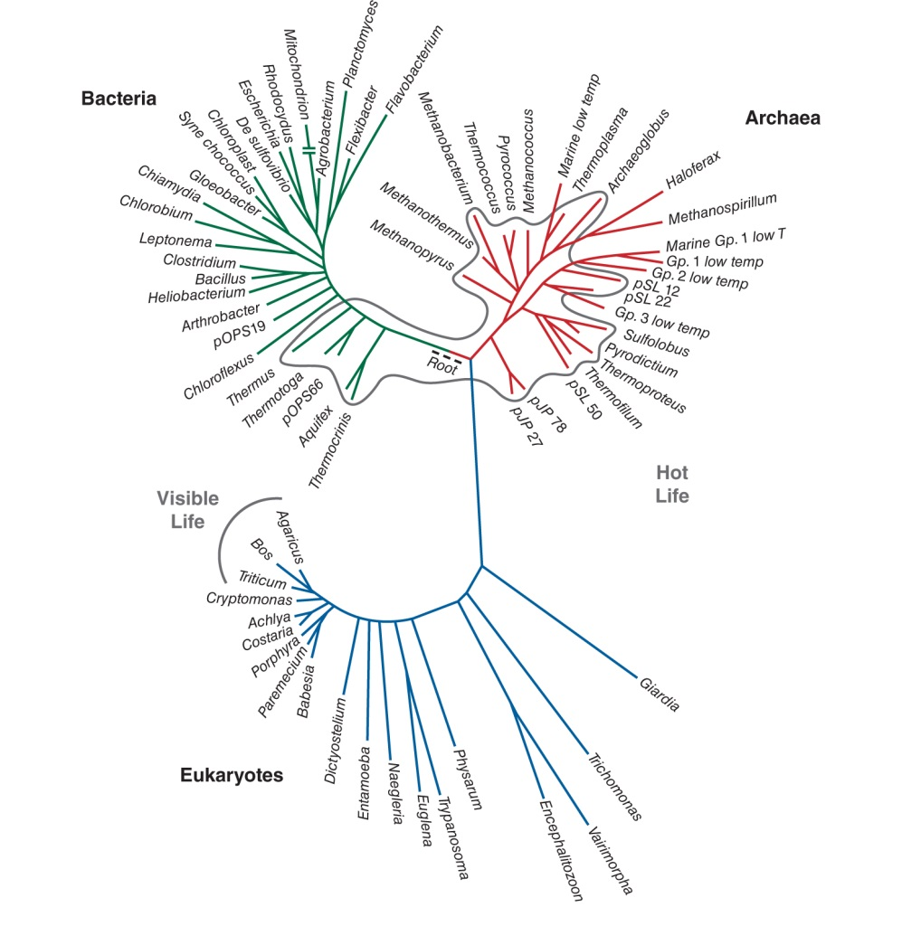
Three domains of life: bacteria, archaea, eukaryotes
B&FG 3e
Fig. 1-3
Page 7

Slide 12
Outline
Organization of the book
Bioinformatics: the big picture
Organization of the chapters
Suggestions For Students and Teachers:
Exercises, Find-a-Gene, Characterize-a-Genome
Bioinformatics software: two cultures
Web-based software
Command-line software
Bridging the two cultures
New paradigms for learning programming
Bioinformatics and other disciplines

Slide 13
Figure 1.4
Bioinformatics and Functional Genomics (3rd ed., 2015)

Slide 14
Figure 1.4
Bioinformatics and Functional Genomics (3rd ed., 2015)

Slide 15
Figure 1.4
Bioinformatics and Functional Genomics (3rd ed., 2015)

Slide 16
Organization of the chapters
Each chapter includes a mix of theory and practice. The best approach is to embrace the material as actively as possible.
As you read about a software program, try using it.
As you read about a web resource, visit it and explore it.
Try the exercises at the end of each chapter.
When a topic is new to you, such as the Linux operating system, command-line software, or the R programming language, take it as an opportunity to increase your familiarity and go deeper. For example, for R try taking some of the free on-line introductions to R that are recommended in the chapters.
Become an active member of the community. Try community resources such as SeqAnswers and Biostars! (Follow their etiquette, e.g. before you post a question check to see if others have already asked it.)
B&FG 3e
Page 8

Slide 17
Outline
Organization of the book
Bioinformatics: the big picture
Organization of the chapters
Suggestions For Students and Teachers:
Exercises, Find-a-Gene, Characterize-a-Genome
Bioinformatics software: two cultures
Web-based software
Command-line software
Bridging the two cultures
New paradigms for learning programming
Bioinformatics and other disciplines

Slide 18
Projects and exercises
In Chapter 4 we introduce the find-a-gene project. You can take ownership of a project, such as discovering a gene that no one knew about before.
In Chapters 15 and 19 we introduce five perspectives on genomics, and suggest a project in which you select your favorite genome (whether human, a virus, a panda, or a mold) and analyze it in terms of these five perspectives.
In an alternative version you can select one favorite gene and analyze it across multiple genomes, again following the five principles we introduce.
B&FG 3e
Page 9

Slide 19
Outline
Organization of the book
Bioinformatics: the big picture
Organization of the chapters
Suggestions For Students and Teachers:
Exercises, Find-a-Gene, Characterize-a-Genome
Bioinformatics software: two cultures
Web-based software
Command-line software
Bridging the two cultures
New paradigms for learning programming
Bioinformatics and other disciplines

Slide 20
Bioinformatics and genomics: two cultures
Many bioinformatics tools and resources are available on the internet, such as major genome browsers and major portals (NCBI, Ensembl, UCSC).
These are:
accessible (requiring no programming expertise)
easy to browse to explore their depth and breadth
very popular
familiar (available on any web browser on any platform)
B&FG 3e
Fig. 2-3
Page 22

Slide 21
Figure 1.5
Bioinformatics and Functional Genomics (3rd ed., 2015)

Slide 22
Bioinformatics and genomics: two cultures
Many bioinformatics tools and resources are available on the command-line interface (sometimes abbreviated CLI).
These are often on the Linux platform (or other Unix-like platforms such as the Mac command line). They are essential for many bioinformatics and genomics applications.
Most bioinformatics software is written for the Linux platform.
Many bioinformatics datasets are so large (e.g. high throughput technologies generate millions to billions or even trillions of data points) requiring command-line tools to manipulate the data.
B&FG 3e
Page 22

Slide 23
Should you learn to use the Linux operating system? Yes, if you want to use mainstream bioinformatics tools.
Should you learn Python or Perl or R or another programming language? It’s a good idea if you want to go deeper into bioinformatics, but also, it depends what your goals are. Many software tools can be run in Linux on the command-line without needing to program.
Think of this figure like a map. Where are you now? Where do you want to go?

Slide 24
Outline
Organization of the book
Bioinformatics: the big picture
Organization of the chapters
Suggestions For Students and Teachers:
Exercises, Find-a-Gene, Characterize-a-Genome
Bioinformatics software: two cultures
Web-based software
Command-line software
Bridging the two cultures
New paradigms for learning programming
Bioinformatics and other disciplines

Slide 25
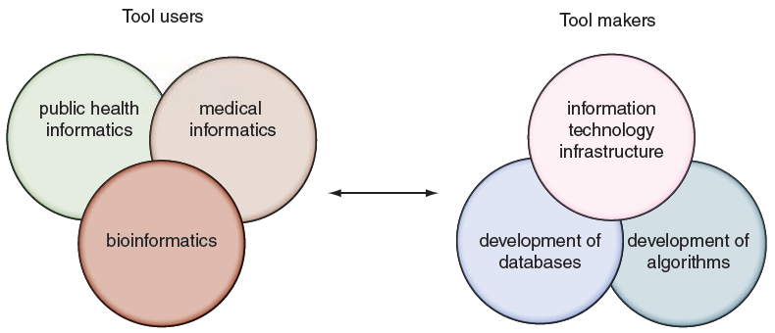
Tool makers and tool users across informatics disciplines
B&FG 3e
Fig. 1.6
Page 15

Slide 26
Tool makers and tool users across informatics disciplines
Many informatics disciplines have emerged in recent years. Bioinformatics is distinguished by its particular focus on DNA and proteins (impacting its databases, its tools, and its entire culture).
B&FG 3e
Fig. 1.6
Page 15

